Slide 1


SEO - Search Engine Optimization

Slide 2

Topics
What is SEO
Introduction to head tag
Tags used inside the head tag (title, link, style, meta )
Introduction to Meta tags and their usage
Benefits of using meta tags
Favicon

Slide 3
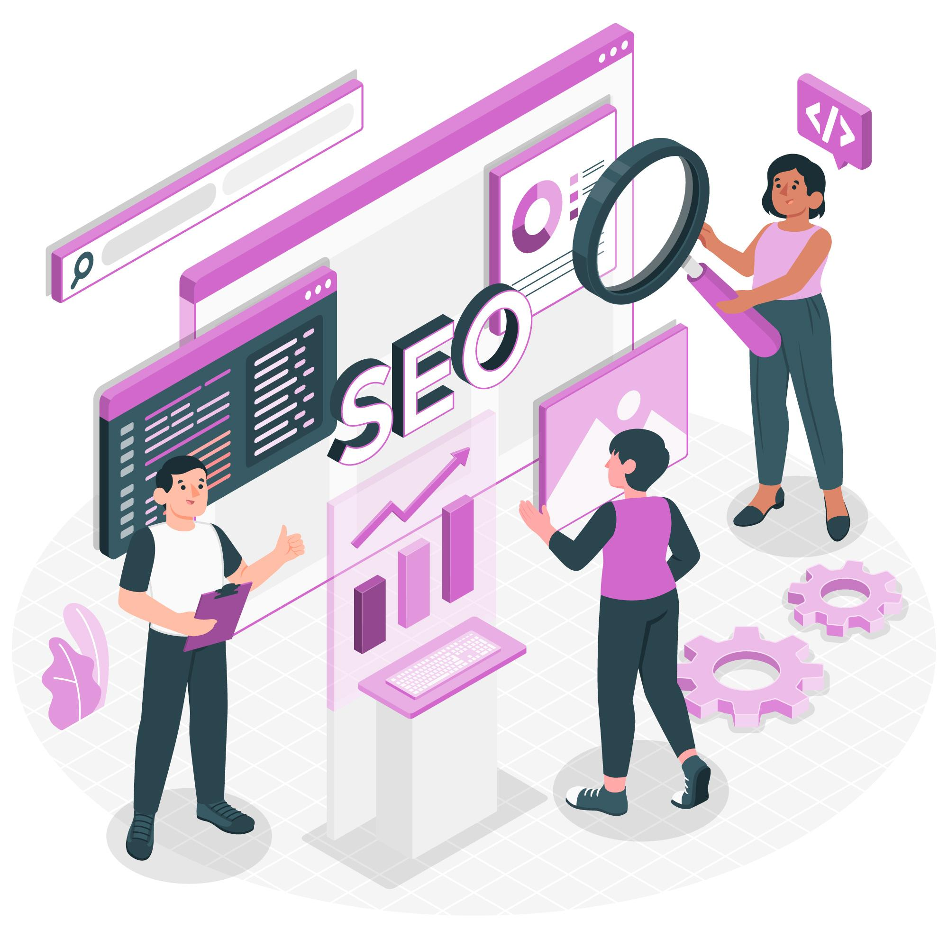
What is SEO
SEO stands for Search Engine Optimization. It helps you optimize your websites so that they have better rankings on Search Engines like Google, Bing and Yahoo.

Slide 4
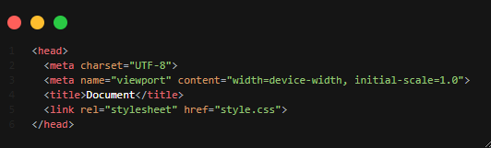
Introduction to the Head Tag
The <head> tag in HTML is indeed an element that contains important information and metadata about the document.

Slide 5
Tags used inside the Head tag
(title, link, style, meta etc )
Some of the commonly used head tag -
The title tag
The link tag
The style tag
Meta tag

Slide 6
Introduction of Meta Tags and their Usage
Meta tag <meta> in HTML is used to provide information about a web page to search engines, browsers, and other web services.
Meta tags include -
Charset
Viewport
Description
Author
Keywords

Slide 7
Benefits of Using meta tags
Some of the Benefits of Meta tags are
SEO (Search engine optimization)
Social Media Sharing
Character Encoding and Language
Viewport controlled
HTTP-Equiv tags
Wb Accessibility

Slide 8
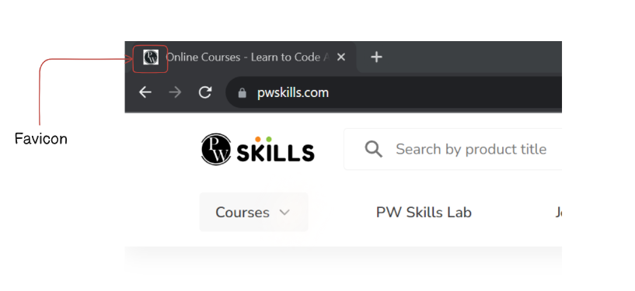
Favicon
A favicon (favourite icon) is a tiny icon included along with a website, which is displayed in places like the browser's address bar, page tabs and bookmarks menu.

Slide 9

THANK YOU

